Slide 1
Unidroit guidance on international best practice for security interest registration
Viet nam workshop
14 – 15 December 2022
Ho Chi minh city
William Brydie-Watson
Senior Legal Officer
UNIDROIT

Slide 2
TABLE OF CONTENTS
Introduction to UNIDROIT 3 - 5
Guide to Best Practices for Electronic Collateral Registries 6 - 8
Critical Performance Factors and Technical Standards 9 - 13
Risk Management 14
Registries under UNIDROIT Instruments: CTC and MAC Protocol 15 - 17
Registries under UNIDROIT Instruments: Model Law on Factoring 18
Further information 19

Slide 3
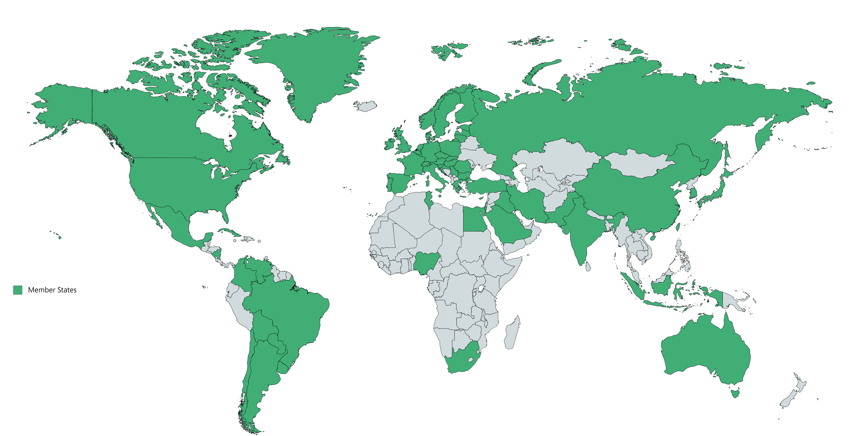
INTRODUCTION TO UNIDROIT
Independent Intergovernmental Organisation
Set up in 1926 as organ of League of Nations
Currently 63 Member States
73.6% world population
90.7% of global nominal GDP
127 Connected States
Develops modern standards for commercial law
Treaties (Conventions, Protocols)
Model Laws
Legal Principles and Rules
Legal Guides
Best Practice Guides
Model Contract Clauses

Slide 4


INTRODUCTION TO UNIDROIT
Diverse Work Programme, UNIDROIT has developed over 30 instruments.
Work often related with development, also with cutting edge best practices in access to finance
Contract Law
Investment Contracts
Capital Markets
Access to Finance
Law and Technology
Private Law and Agriculture
Sustainable development
International Procedural Law

Slide 5












INTRODUCTION TO UNIDROIT
Standard setting legislative activity, together with UNCITRAL & HCCH, the “Three Sisters”
Work in close collaboration with International Organisations and International Financial Institutions:
World Bank / IFC
EBRD, ADB, AIIB
IMF, BIS/Basel, OECD
FAO/IFAD
ALI/ELI

Slide 6
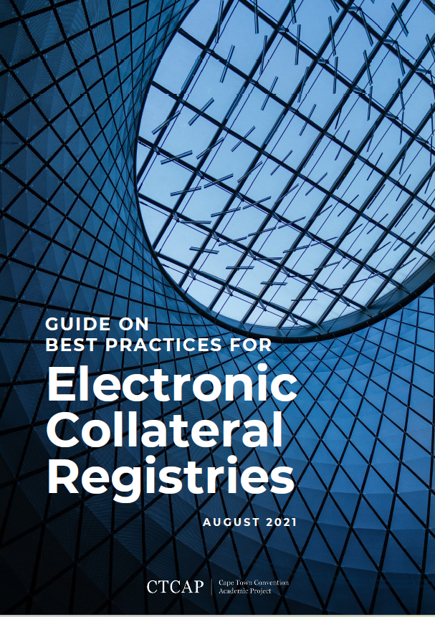
GUIDANCE ON BEST PRACTICES FOR ELECTRONIC COLLATERAL REGISTRIES
UNIDROIT, University of Cambridge and Aviation Working Group jointly developed the Guide on Best Practices for Electronic Collateral Registries (BPER),
Developed 2015 - 2021.
Negotiations included from participation from international organisations (World Bank Group, EBRD, APEC), Governments (AFSA) and private sector (ISC, Aviareto, Bsystems and Piercom).

Slide 7
GUIDANCE ON BEST PRACTICES FOR ELECTRONIC COLLATERAL REGISTRIES
SCOPE
The Guide examines best practices in current use in the field of electronic registry design and operation, focusing specifically on electronic collateral registries (ECRs).
The ECRs should be understood broadly. They encompass registries for notices of security rights as envisaged in UNCITRAL and UNIDROIT instruments, and electronic registries established for the registration of notices relating to a specific type of transaction, such as finance leases or assignments of receivables.
The Guide can also apply to registry systems functionally similar to collateral registries operated by public entities, including motor-vehicle registries, intellectual property registries, and companies registries.

Slide 8
GUIDANCE ON BEST PRACTICES FOR ELECTRONIC COLLATERAL REGISTRIES
Critical Performance Factors (CPFs)
The Guide aims to identify best practices that exclude or mitigate the risks and liabilities faced by ECRs in performing their core functions.
The Project has identified Critical Performance Factors (CPFs) constituting the best practice for ECRs.
CPFs are “registry system properties and processes without which an ECR is unable to perform its core functions at a level that meets the reasonable expectations of the relevant market participants”.
CPFs are the characteristics of an ECR that are essential for it to be considered fit for purpose.

Slide 9
GUIDANCE ON BEST PRACTICES FOR ELECTRONIC COLLATERAL REGISTRIES
The 16 Critical Performance Factors (CPFs)
Access Control
Accessibility
Authentication
Availability
Confidentiality
Continuity
Disposition (Disposal)
Integrity
Interoperability
Legal Authority and Compliance
Legal Authority of the Registrar
Reliability
Retention
Timeliness
Trustworthiness
User-Centered Design
Validation

Slide 10
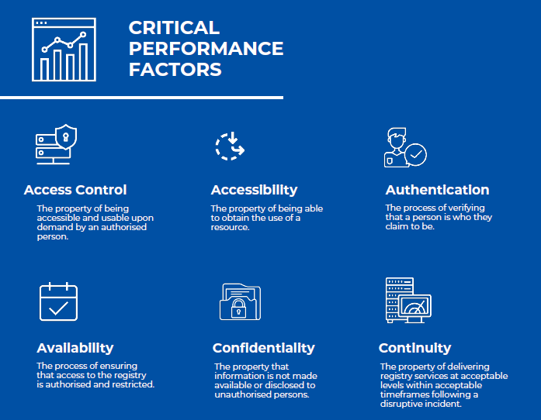

Slide 11
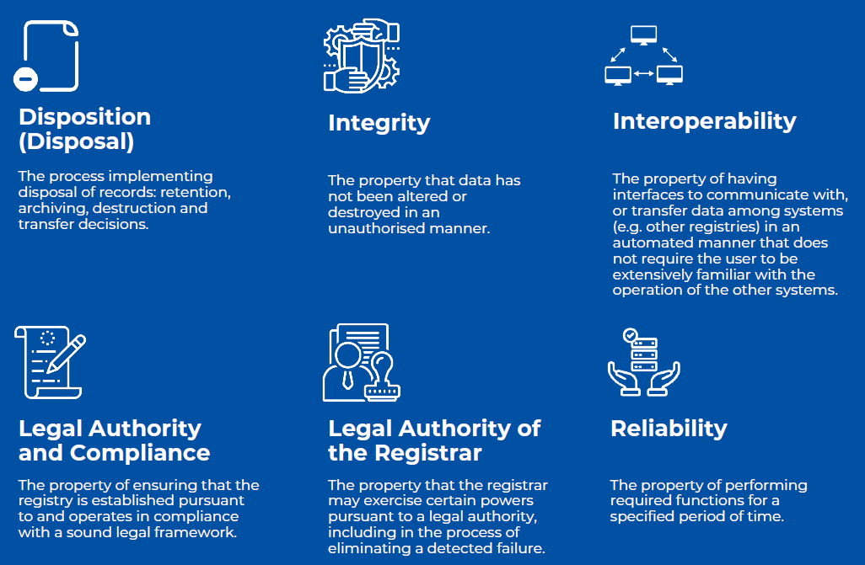

Slide 12
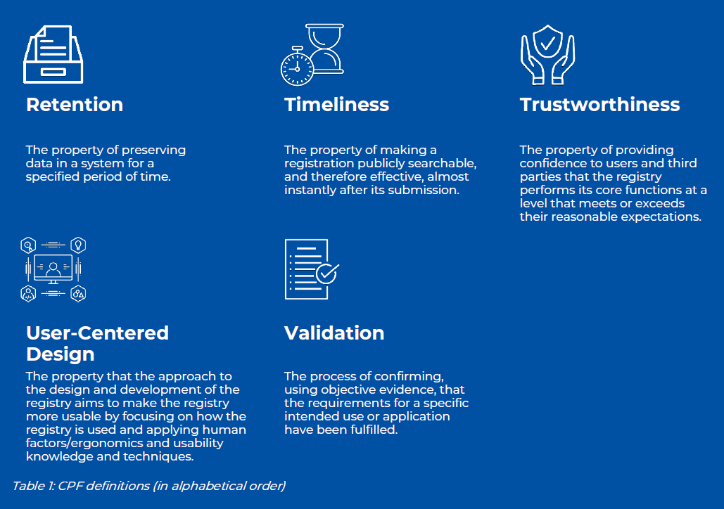

Slide 13
GUIDANCE ON BEST PRACTICES FOR ELECTRONIC COLLATERAL REGISTRIES
CPF Technical Standards (ISO)s
Access Control ISO 207000: 2018, 27001:2013
Accessibility ISO 40500:2012
Authentication ISO 9798-1
Availability ISO 27000:2018 (3.7)
Confidentiality ISO 27000:2018 (3.10)
Continuity ISO 22301:2019
Disposition ISO 15489-1:2016
Integrity ISO 27040:2015
Interoperability ISO 27040:2015 (7), 39794-1:2019
Legal Authority and Compliance
Legal Authority of the Registrar
Reliability ISO 27040, 25010:2011
Retention ISO 27001:2013, 27040:2015
Timeliness ISO 25012:2008
Trustworthiness ISO 16363:2012
User-Centered Design ISO 9241-210:2019
Validation ISO 27000:2018, ISO9000

Slide 14
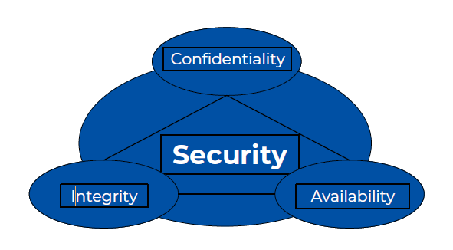
GUIDANCE ON BEST PRACTICES FOR ELECTRONIC COLLATERAL REGISTRIES
Risk Management
Three CPFs form the triad that can be considered core CPFs, whose performance is enhanced by, or dependent on 13 other CPFs:
1. Confidentiality: Authentication and Access Control to prevent unauthorised access to confidential information.
2. Integrity: Reliability, Retention, Validation, and in some cases: Authentication, Access Control, and Disposition. User-Centered Design may improve data entry accuracy. The Legal Authority of the Registrar to correct errors may be necessary from time to time.
3. Availability: Accessibility, Reliability, and Continuity; in certain cases, it may require Interoperability.

Slide 15
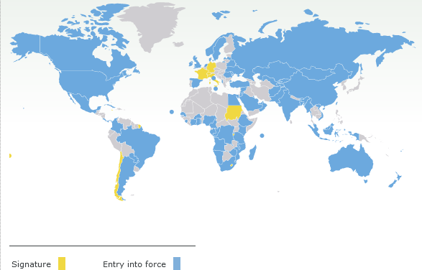
REGISTRIES UNDER UNIDROIT INSTRUMENTS
The Cape Town Convention and its Protocols
The Cape Town Convention system is one of the most successful international commercial law instruments in history.
Uniform legal regime created by treaty to increase certainty and reduce risk in the financing and leasing of certain types of uniquely identifiable, mobile high value equipment used in specific industry sectors.
Separate international registries established under each Protocol:
Aircraft Protocol (2001)
Rail Protocol (2007)
Space Protocol (2009)
Mining, Agricultural and Construction Protocol (2019)
CTC: 84 Contracting States
Viet Nam CTC and Aircraft Protocol: 2014

Slide 16
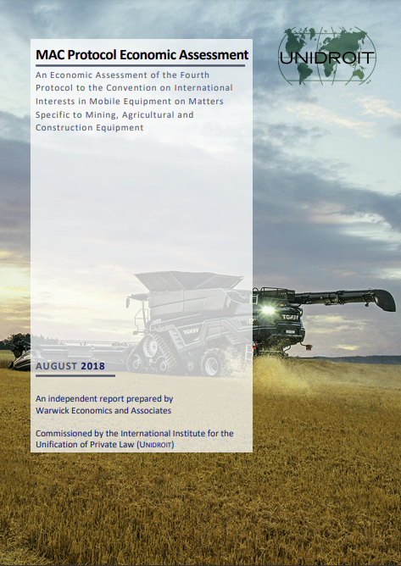
REGISTRIES UNDER UNIDROIT INSTRUMENTS
The Cape Town Convention and its Protocols
THE MAC PROTOCOL
Newest Protocol to the Cape Town Convention. Large economic impact:
MAC Protocol predicted to increase the stock of MAC equipment by $90 billion
Total impact on global GDP equivalent to $30 billion a year
Increase GDP $23 billion (developing)
Increase GDP $7 billion (developed)
https://www.unidroit.org/english/documents/2018/study72k/1808-final-mac-protocol-ea.pdf

Slide 17

REGISTRIES UNDER UNIDROIT INSTRUMENTS
The MAC International Registry and Viet Nam
The asset-based mining, agriculture and construction equipment international registry will operate separately to domestic registries.
International interests registered in the international registry have priority over domestic interests.
Article XVI of the MAC Protocol allows Contracting States to designate domestic entry points into the International Registry, which allows interaction between domestic registries and the MAC Registry.
MAC Protocol Registry to be operational by 2024, Viet Nam encouraged to ratify MAC Protocol.

Slide 18
REGISTRIES UNDER UNIDROIT INSTRUMENTS
The Model Law on Factoring
UNIDROIT is currently developing a Model Law on Factoring (involving IFC, UNCITRAL), which will be adopted in May 2024.
The MLF will provide model provisions for States that have already reformed their secured transactions law but wish to consider implementing additional specific rules to improve their legal framework for factoring.
The MLF provides for a transferor-based registry for the registration of notices of transfers (including security transfers). Registry rules set out in Annexe A, rather than directly in Chapter IV.
As Viet Nam already has already reformed its secured transactions law, Viet Nam should consider the Model law on Factoring provisions to ensure that transfers of receivables can be properly registered in the domestic collateral registry.

Slide 19

FURTHER INFORMATION
Electronic Registries Guide: https://unidroitfoundation.org/e-registry-best-practice/
MAC Protocol: https://www.unidroit.org/instruments/security-interests/mac-protocol/overview/
Model Law on Factoring: https://www.unidroit.org/work-in-progress/factoring-model-law/
William Brydie-Watson Senior Legal Officer w.brydie-watson@unidroit.org

