Slide 1

Uniform Law for Sustainable Development:
The UNIDROIT/FAO/IFAD Guide
on Contract Farming
Prof. Anna Veneziano
Deputy Secretary General
UNIDROIT

Slide 2
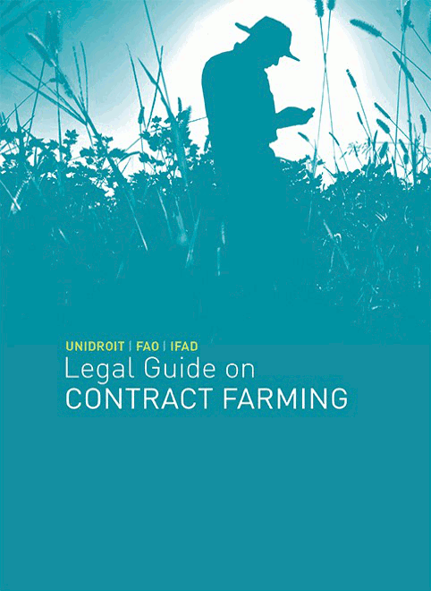
UNIDROIT/FAO/IFAD LEGAL GUIDE ON CONTRACT FARMING
Published in 2015 by UNIDROIT in cooperation with the two UN Rome-based specialised organisations:
  Food and Agricultural Organization (FAO)
  International Fund for Agricultural Development (IFAD)
Text available on the UNIDROIT website in several languages:
English, French, Spanish, Portuguese, Chinese
https://www.unidroit.org/english/guides/2015contractfarming/cf-guide-2015-e.pdf

Slide 3
UNIDROIT’s work in the field of agriculture
    The idea for UNIDROIT to work in the area of agricultural development originated in 2009 with a memorandum presented to the Governing Council on “Private Law and Economic and Social Development”
    An important step was the Colloquium in Rome in 2011 on “Promoting Investment in Agricultural Production: Private Law Aspects”, where the synergy with the multilateral organisations working for agricultural development was explored (FAO; IFAD)
    Potential areas of work were defined:
      Contract farming → - 2015 UNIDROIT/FAO/IFAD Legal Guide - LGCF
      Financing of agriculture → - 2020 UNIDROIT/IFAD Legal Guide on Agricultural Land Investment Contracts – ALIC
      - 2019 MAC Protocol to the Cape Town Convention
      - Ongoing project with UNCITRAL on a Model Law on Warehouse Receipt
      Legal structure of enterprises → - Ongoing UNIDROIT/FAO/IFAD project
      Title to land

Slide 4
UNIDROIT’s work in the field of agriculture (2)
CONTRACT LAW AND AGRICULTURE
LEGAL STRUCTURE OF AGRICULTURAL ENTERPRISES
(WP 2020-2022)
ACCESS TO FINANCE IN AGRICULTURE
UNCITRAL-UNIDROIT MODEL LAW ON WAREHOUSE RECEIPTS (ongoing)
UNIDROIT/IFAD
LEGAL GUIDE ON AGRICULTURAL LAND INVESTMENT CONTRACTS (ALIC)
(2021)
UNIDROIT/FAO/IFAD
LEGAL GUIDE ON CONTRACT FARMING (2015)
«MAC» PROTOCOL TO THE CAPE TOWN CONVENTION (2019)

Slide 5

UNIDROIT’s work in the field of agriculture (2)
KEY ROLE OF THE CONTRACT to create a balanced investment relationship
Interplay with the REGULATORY FRAMEWORK

Slide 6

Role of the contract and legal guidance documents
General Principles elaborated at international level
CFS Principles for Responsible Investment in Agriculture and Food Systems (CFS-RAI Principles)
UN Global Compact
Voluntary Guidelines on the Responsible Governance of Tenure of Land, Fisheries and Forests in the Context of National Food Security (VGGT)
Legislation at national or regional level
Model contracts, standard terms…
GUIDANCE DOCUMENTS CONTAINING A MORE SPECIFIC (PRIVATE) LAW FRAMEWORK

Slide 7
CONTRACT FARMING AS A RISK MANAGEMENT TOOL
IN AGRICULTURAL VALUE CHAINS
Contract farming as an intermediate form
of coordination and connection between production and (international) markets:
Based on an agreement prior to production:
The buyer agrees with the farmer on the commodity (type, quantity, quality attributes), on place and time of delivery, often on production methods
The buyer agrees to sell for a price (or price formula) set in advance, which takes the provided inputs and services into account)
The buyer generally provides support for the production: material inputs, financing, technical assistance, monitoring of production…

Slide 8
POTENTIAL BENEFITS OF CONTRACT FARMING?
KEY POTENTIAL ADVANTAGES FOR CONTRACTORS:
guaranteed access and regularity of supply of the commodity
conformity to product quality and safety standards and traceability control
facilitated access to land without land acquisition
KEY POTENTIAL ADVANTAGES FOR FARMERS:
a secured output market and stabilized income, mitigated production risks
facilitated access to inputs, services, technology, credit and financing, enhanced production methods
empowerment with agronomical skills
no interference with land right issues

Slide 9
POTENTIAL BENEFITS OF CONTRACT FARMING?
KEY POTENTIAL GLOBAL ECONOMIC AND SOCIAL ADVANTAGES:
Food security objectives:
  early planning and better alignment between production and demand
  enhance the stabilization of markets and limit price volatility
  contribute to higher quality of produce
Economic development:
  private sector’s input (investment capacity, advanced technology, and facilitated access to export markets)
  Empowerment of farmers and support transition from a subsistence production to a commercial/ market-oriented production
  Economic and social development of rural areas

Slide 10

POTENTIAL RISKS FOR PARTIES?
POTENTIAL RISKS FOR FARMERS:
asymmetrical relationship in access to information, exposure to risks, bargaining power …
small farmers in disadvantage against commercially oriented farmers
potentially high dependency on the buyer regarding access to inputs, credit etc. and risk of growing indebtedness.
risks of unfair conditions and fraudulent practices by buyer, with difficult or unavailable redress mechanisms
shift to monoculture entails risks regarding access to subsistence crops, loss of biodiversity, environmental threats…
POTENTIAL RISKS FOR CONTRACTORS:
viability of the investment
Potentially high transaction costs
Risk on farmers’ non compliance with quality requirement, proper use of inputs, delivery of the agreed commodity (no side-selling)…

Slide 11

UNIDROIT/FAO/IFAD LEGAL GUIDE: NATURE, PURPOSE, CONTENT
Promotion of good practices:
  The aim is to reach a fair and enforceable agreement in application of basic principles:
    Fair and loyal dealings
    Transparency
    Cooperation between parties
    Effective and proportionate remedies
    Easy and fair settlement of problems arising during performance and in final dispute resolution with a view to keeping the value of the relationship

Slide 12
CONTRACT FARMING
IN THE UNIDROIT-FAO-IFAD LEGAL GUIDE
Bilateral contract farming relationship between:
a “producer” (farmer producing agricultural commodities, either as an individual or through a cooperative or other associative venture, including indigenous communities),
and a “contractor” (a commercial purchaser, investor, exporter and/or food processor, typically an agribusiness company, but also non-commercial such a public or religious entity)
Third parties are usually involved: depending on the commodity, country, etc. (credit institutions, certification bodies, NGO’s, governmental bodies (also within a Public Private Partnership – PPP))

Slide 13
ORIGINAL FEATURES
OF AGRICULTURAL PRODUCTION UNDER CONTRACT
Remarkably uniform wherever used, but:
  impact of domestic laws and practices as well as the different economic environment may introduce important variations
Generally, stable, long-term relationship with frequent interaction between parties
  Importance of providing risk-sharing tools and alternatives
Generally, not an international contract, but:
  Impact of international/regional standards
  Impact of contracts concluded along the value chain

Slide 14
UNIDROIT/FAO/IFAD LEGAL GUIDE: NATURE, PURPOSE, CONTENT
  Description of contractual phases and issues to be considered:
  The Guide follows the development of the contract from the negotiation phase to remedies and dispute resolution:
    Parties, formation and form; Obligations of the parties; Excuses for non-performance; Remedies for breach; Duration, Renewal, and Termination; Dispute Resolution
    The Guide highlights the interplay with the national or international private law and/or regulatory framework
    A general approach, to be adapted to domestic legal, economic and social environments

Slide 15
A SPECIFIC EXAMPLE:
PRICE DETERMINATION MECHANISMS
Chapter 3 of the Legal Guide
Price as a central element in the sustainability of the relationship for both parties
The issues discussed in the Legal Guide include:
  May the parties freely agree on the price and at what time?
  Is it an essential term of the contract?
  Situations where price terms may be invalidated under the applicable law
  Illustration of advantages and risks of common price determination mechanisms:
    fixed prices
    flexible prices with scales according to quality, performance or yield (bonus and penalties)
  Examples of good practices:
    transparency regarding price mechanisms
    Cooperation
    mutual profitability
    considering mechanisms for price adjustment for long term contracts

Slide 16
HOW CAN A GUIDANCE INSTRUMENT BE SUCCESSFUL?
NEED TO INVOLVE ALL ADDRESSEES/STAKEHOLDERS IN THE DRAFTING AND SUBSEQUENT IMPLEMENTATION
  Contract parties and their representatives
    Early involvement in Working Group and consultation events
  International organisations engaged (also) in field work
    Field work needed!
  Legislators defining public policy in contract farming and related areas
    Specificities of domestic legal, social and economic environment to be taken into account!
  National cooperation agencies

