Slide 1

Legal Frameworks for the Securitisation and Transfer of Small Satellites E7. IISL Colloquium on the Law of Outer Space - 4. Small Satellites, Public and Private Law Perspectives 76th International Astronautical Congress, Sydney, Australia, 29 Sep – 03 Oct 2025
Hamza Hameed, Head of Space & Development, Access Partnership
William Brydie-Watson, Senior Legal Officer, UNIDROIT
Disclaimer: The views expressed in this presentation are our own and do not necessarily reflect those of our organization(s).

Slide 2
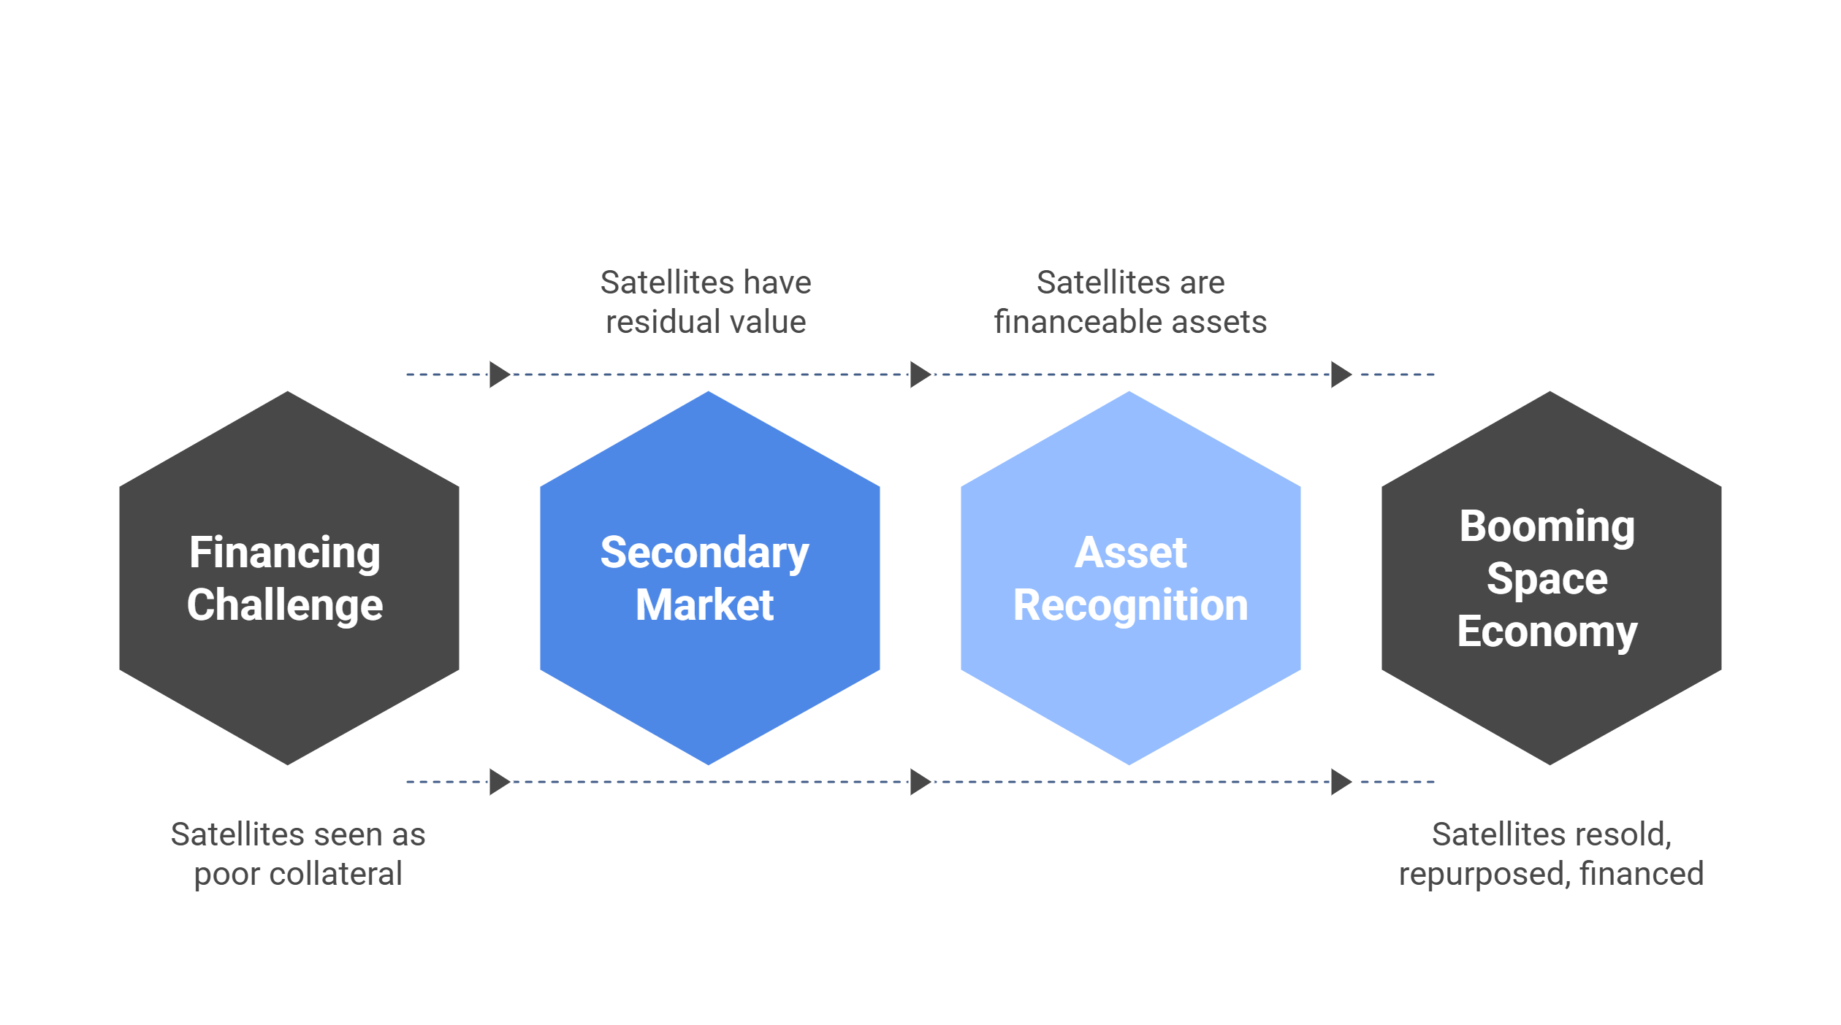
Introduction – Small Satellites & Secondary Markets
Smallsat Revolution: Rapid growth of small satellites is driving a booming space economy (projected ~$1.8 trillion+ by 2040). NewSpace start-ups are proliferating, but many are thinly capitalized.
Financing Challenge: Traditionally, satellites were financed via project finance (secured by service contracts) rather than asset-based loans. Orbiting satellites were seen as poor collateral – non-repairable, hard to repossess, essentially disposable assets.
Need for Secondary Market: Technical advances (on-orbit servicing, software deployed satellites, GSaaS) now give satellites residual value. This opens the door to a secondary market for used satellites, allowing them to be resold or repurposed instead of becoming debris.
Securitisation as Enabler: Treating satellites as assets that can be securitised (used as collateral or bundled into asset-backed financing) is key to unlocking this secondary market. It provides liquidity and attracts investment by turning satellites into tradable, financeable assets.

Slide 3
Public vs Private Law Considerations
Public International Law | Private/Commercial Law
Outer Space Treaty 1967 and related UN treaties form the backbone of public space law. They impose obligations on states (e.g. authorize and continually supervise national space activities, accept liability for damage) and affirm that outer space is beyond national appropriation. | By contrast, commercial dealings with satellites (ownership transfer, financing, insurance) fall under private law. There is a gap in clear property and security rights for space assets at the international level. Each country’s national law may treat satellite assets differently, risking conflicts and uncertainty in cross-border deals.
Bridging the Divide
An effective framework must reconcile public law duties (safety, registration, liability) with private law needs (asset ownership clarity, creditor rights). This ensures nations meet their treaty obligations and enable commercial transactions in satellites. A failure to harmonize can lead to disputes and deter investment.

Slide 4



Licensing Constraints & International Obligations
National Licensing | Spectrum & Orbital Slots | Approvals for Transfer
States (per OST Art. VI) must authorise & supervise private missions Launch, operation, spectrum, and orbital slot licences required Often non-transferable → new owner must reapply | ITU coordinates frequencies & orbital positions globally No property rights in spectrum or slots Without valid slot + frequency, satellite has no commercial use | Many regimes require regulator consent for asset transfers Example: Hong Kong law forbids granting security interest without consent Ensures oversight, but raises costs and uncertainty for financiers
Licences are the real value-driver. Hardware alone cannot operate without regulatory approvals.
Notes:
“Licences are the real value-driver. Hardware alone cannot operate without regulatory approvals.”
National Licensing: States are required by Article VI of the Outer Space Treaty to authorize and supervise private satellite missions. Licenses (for launch, operation, spectrum use, orbital slots) are mandatory in all major jurisdictions. These licenses are often non-transferable, meaning a satellite’s new owner must obtain fresh approvals.
Spectrum & Orbital Slots: International coordination (via ITU) is needed for radio frequencies and orbital positions. No property rights exist in spectrum or orbital slots under international law. A satellite without an assigned slot and frequency cannot be operated commercially. This regulatory reality complicates secondary sales – the asset’s utility depends on permits that do not automatically follow the hardware.
Regulatory Approvals for Transfer: Many jurisdictions tie licenses to the original operator, requiring governmental consent to any change in control or ownership of the satellite. Example: Hong Kong’s Outer Space Ordinance attaches a license condition that forbids granting a security interest in the satellite without prior regulator consent. Such rules ensure states retain oversight, but they raise transaction costs and uncertainty for financiers.

Slide 5
International Liability: Under the Outer Space Treaty and the Liability Convention (1972), launching states bear international liability for damage caused by their space objects. This liability persists even if the satellite is sold or moved to a new operator. States therefore have a stake in any transfer – they remain “on the hook” for accidents caused by the object they launched.
Risk Allocation: When satellites change hands, parties must manage liability risk. Typically, this is done via insurance and indemnities. National licensing often requires launch and in-orbit liability insurance. A new owner may need to re-register the satellite with a state and secure insurance coverage, to assure prior launching states that liability is addressed.
Transfer Safeguards: To enable transfers without compromising safety or increasing debris, legal frameworks can impose safeguards. For instance, a state might require approval before a creditor or buyer deorbits or moves a satellite.
Liability and Risk Management in Transfers

Slide 6



Role of Secured Transactions Law in Space Finance
What is Secured Transactions Law? | It governs the use of assets as collateral for credit. By creating and enforcing security interests in movable property, it lets lenders repossess or claim value from the asset if a debtor defaults. In industries with high-value mobile assets (aircraft, ships, etc.), this is a cornerstone of financing.
Application to Satellites: | Secured financing for satellites means a lender accepts the spacecraft itself as collateral for a loan. This can lower the cost of capital and increase credit availability for space companies. The ability to give security directly impacts the cost and availability of credit. For NewSpace startups with few tangible assets beyond their satellites, using those satellites to secure loans may be the only way to raise non-dilutive financing.
Challenges: | Without a clear legal regime, lenders historically viewed satellite liens as “illusory” – the asset was hard to reach or resell, making the security interest of dubious value. Thus, space financing defaulted to project finance (relying on long-term service contracts rather than the asset). Modern secured transactions law aims to change that by providing certainty and priority in interests even for orbiting assets, thereby giving lenders confidence that they can enforce rights or recover value (e.g. through insurance or sale) if needed.

Slide 7
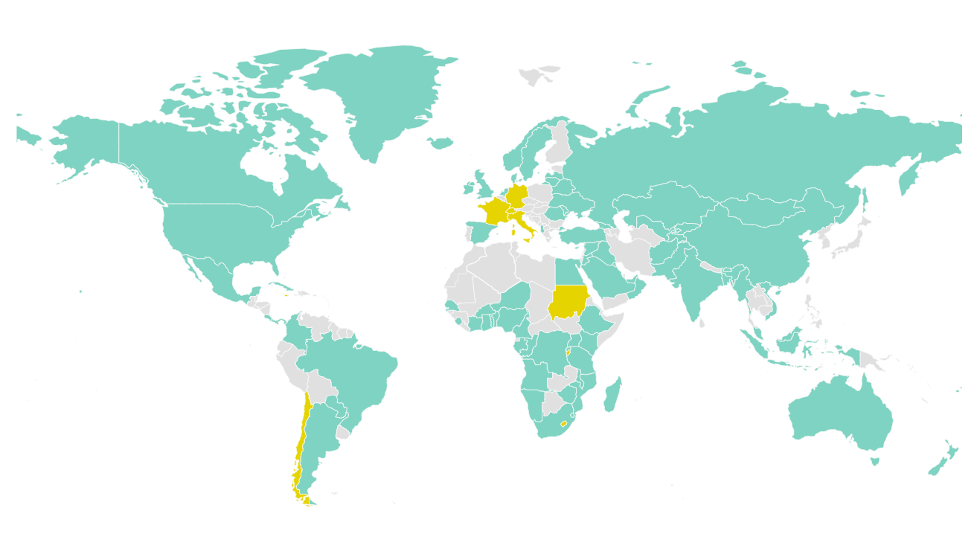
The Space Protocol to the Cape Town Convention
International Framework
UNIDROIT treaty (Berlin, 2012) extending Cape Town Convention to space assets Builds on success of Cape Town: 90 Contracting States for Convention and Aircraft Protocol. Protocols also exist for Rail, and Mining, Agriculture and Construction sectors
Key Features
International registry for space assets (uniform global recognition) Creates an “international interest” via security agreements, leases, or title reservations First-to-register priority rule → predictability for creditors Enforcement via TT&C escrow arrangements (functional control)
Safeguards & Status
Includes Public Service exception (protects vital services) Not yet in force (needs more ratifications) If adopted: clarifies title, lowers financing costs, enables secondary market
Notes:
International Framework: The Space Protocol (Berlin, 2012) is an UNIDROIT-sponsored treaty that extends the Cape Town Convention’s asset-based financing system to space assets (satellites, etc.). The Cape Town Convention is a successful global regime for securing interests in high-value mobile equipment that already has 90 Contracting States around the world. The Space Protocol adapts this model to outer space’s unique challenges.
Key Features: It creates an international registry for space assets, allowing registration of security interests that all Contracting States must recognize. It defines a uniform “international interest” in space assets that can be created by security agreements, leases, or title reservation contracts. Priority of interests follows a clear first-to-register rule, which improves predictability for creditors. Enforcement provisions are tailored: e.g. creditors may contract for access to the satellite’s TT&C codes (control signals) held in escrow, enabling them to take control on default – subject to respecting national laws.
Safeguards and Status: The Space Protocol includes safeguards mindful of public law (e.g. a Public Service exception to delay creditor remedies if the satellite provides vital services). It is not yet in force (requiring more ratifications), but it offers a ready-made solution to harmonize private rights in space assets. If adopted widely, it would clarify title, streamline asset transfers, reduce financing costs, and ultimately facilitate a secondary market for satellites by giving financiers and buyers greater legal certainty.

Slide 8
Case Studies & Enablers of a Secondary Market
Comparative Case Studies | Enablers of Transferability
United States: Security interests under UCC; regulatory reforms simplify licensing, but no international harmonisation → cross-border uncertainty. Malta: Proactive legal strategy (Space Activities Act + Securitisation Act) to attract investment; securitisation structures could bundle satellite revenues. Hong Kong: Outer Space Licence requires regulator consent before granting security interests; formalistic regime impedes financing. Australia: PPSA allows satellites as collateral; workable system if paired with clear regulatory guidance, but no adoption of the Space Protocol yet. | Clarity of Title: Recognised ownership rights (registries, uniform rules) reduce ambiguity, making satellites liquid assets. Repurposability: On-Orbit Servicing, modular design, software-defined payloads → extend life and expand uses. Combined Impact: Reliable title + adaptable assets underpin securitisation, boosting liquidity, investor confidence, and secondary market growth.
Notes:
Case studies: United States: The U.S. has no specific space asset collateral regime equivalent to the Space Protocol. Security interests in satellites are treated under the UCC (as goods or general intangibles), and various federal agencies regulate satellite operations. Recent commercial space regulatory reforms aim to simplify licensing (e.g. unified licensing through the Space Bureau, updated FCC smallsat rules) to foster innovation. However, absence of a uniform international framework means cross-border recognition of a U.S. lender’s interest is uncertain. The U.S. approach highlights the gap between advanced financing law domestically and the need for international harmonization.
Malta: Malta is positioning itself as a space finance hub. It introduced a Space Activities Act to provide regulatory certainty for commercial space operators. Malta also has a dedicated Securitisation Act, and innovative structures like Securitisation Cell Companies, which could be leveraged for space assets. By aligning local laws with international best practices, Malta seeks to attract foreign investment in the space sector. For example, a Maltese structure could bundle satellite revenue streams or leases into investable securities. This proactive legal strategy exemplifies how smaller states can create niche frameworks supporting a secondary market in space assets.
Hong Kong: Hong Kong’s approach underscores regulatory constraints. Operating a satellite from Hong Kong requires an Outer Space Licence, and regulatory consent is required before creating any security interest in the satellite. Hong Kong retains a traditional common law system for secured transactions (no blanket PPSA law). Charges on assets must be registered under the Companies Ordinance, and the century-old Bills of Sale Ordinance may apply to asset pledges. These formalistic requirements, plus the licensing consent hurdle, make asset-based satellite financing cumbersome. Hong Kong’s case suggests that without reform (or adoption of something like the Space Protocol), legal friction will continue to impede a secondary satellite market.
Australia: Australia offers a contrasting example. It adopted a modern Personal Property Securities Act (PPSA) in 2009, embracing a functional approach to security interests. In principle, a satellite can be used as collateral and a security interest perfected by registration in the national PPSR system. Unlike Hong Kong, Australia has no explicit prohibition on satellite security interests, though satellite operations are licensed (e.g. via ACMA for orbital slots). Uncertainty remains: regulators require proof of financial and technical capacity, and it’s unclear if granting a security interest triggers any “significant change” notification. Australia has not yet adopted the Space Protocol, but its PPSA demonstrates how domestic secured transaction law can facilitate space asset financing if paired with clear regulatory guidance.
Legal Title Clarity & Asset Repurposability – Enabling Transferability
Clarity of Title: A fundamental enabler of any secondary market is confidence in legal title. Clear ownership rights – recorded in registries and recognized across borders – reduce ambiguity for buyers and creditors. When a satellite’s title can be definitively established and transferred without legal quagmires, it becomes a more liquid asset. For instance, secured transactions law (and treaties like the Space Protocol) strive to define and protect title rights in space assets and provide clear rules and procedures for transferring title, ensuring transfers are efficient, transparent, and enforceable.
Asset Repurposability: Technological innovation is making satellites more repurposable, boosting their second-hand value. On-Orbit Servicing (OOS) can refuel and refurbish aging satellites, extending their life beyond the initial mission. Satellites with modular designs or software-defined payloads can be retrofitted or reprogrammed for new uses (e.g. an earth observation microsat turned into a communications relay). This adaptability means a used satellite is not just space junk – it can be an opportunity for a new revenue stream in a different application. Satellites are becoming flexible, serviceable assets; in time this leads to satellites having residual value and a livelier secondary market for orbital assets can be expected.
Combined Impact: When legal frameworks ensure reliable title transfer and technology ensures asset reuse, small satellites can truly be traded like other capital assets. An owner can sell or collateralize a satellite with confidence that (a) they can convey good title to the buyer/lender, and (b) the asset will retain utility for the next user. This combination underpins securitisation: investors can buy securities backed by satellite assets or revenues, trusting that those assets are both legally secure and physically valuable. The result is greater liquidity and investment in the space sector, accelerating innovation and growth.

Slide 9
Conclusion – Towards a Thriving Small Satellite Market
Unlocking Capital: | Developing a robust secondary market for small satellites is crucial for sustaining NewSpace ventures. It lowers entry barriers by allowing companies to recoup value from satellites post-mission or use them to secure financing. A comprehensive legal framework that integrates public law obligations with private law rights will unlock significant capital flows into the sector.
Clarity Breeds Confidence: | In summary, legal certainty (clear title, priority, compliance with international duties) and technical innovation (repurposability, standardization) together will foster a vibrant market for second-hand and securitised satellites. Establishing an accepted legal infrastructure – potentially via the Space Protocol’s entry into force or analogous national measures – will give financiers and operators the confidence to treat small satellites as true assets with enduring value. This ultimately benefits the entire space ecosystem, driving growth while managing risk responsibly.
Progress & Next Steps: | Signs of progress include national reforms (e.g. streamlined licensing in the US, new space laws in jurisdictions like Malta) and the groundwork laid by instruments like the Space Protocol (which was recently ratified by Paraguay). However, gaps remain until more countries adopt uniform rules. International cooperation (through UNIDROIT, UNCOPUOS, etc.) is needed to harmonize standards for space asset financing and transfers. A new coalition is being built to more carefully assess the benefits of the Space Protocol and how it can assist in facilitating asset-based finance and growth in the Space industry.

Slide 10
Thank you. Any questions?
hamza.hameed@accesspartnership.com
w.brydie-watson@unidroit.org

